Slide 1
PhD SYNOPSIS · BOARD OF ADVANCED STUDIES & RESEARCH (BASR)
A Leakage-Safe Framework for Observability-Aware Regression Testing of Quantum Compilers
Catching the transpiler regressions the standard output check cannot observe
Furqan Nasir
PhD Scholar in Computer Science
City University of Science & IT, Peshawar
August 2026
Notes:
Respected Chair and members of the Board of Advanced Studies and Research, thank you for the opportunity to present my PhD synopsis. My research is titled “A Leakage-Safe Framework for Observability-Aware Regression Testing of Quantum Compilers.” The central problem is simple: a quantum compiler can regress even when its final output still appears correct. I therefore investigate how to expose faults that conventional output checks cannot observe, while selecting tests under realistic time and computing budgets. I will present the research gap, the proposed framework, the feasibility evidence obtained so far, and the plan for completing the study.

Slide 2

FOLLOWING THE PROPOSAL CHAPTERS
Outline
1
Introduction
2
Literature Review
3
Proposed Methodology
4
Initial Results
5
Work Plan
6
Summary & Q&A
PhD Synopsis · A Leakage-Safe Framework for Observability-Aware Regression Testing of Quantum Compilers
2
Notes:
I will follow the same structure as the proposal. I will begin with the research context, problem statement, questions, objectives, scope, and expected contributions. I will then position the work in the literature and explain what remains unresolved. The third section presents the methodology: the pipeline, the matched-oracle strategy, and the cost-aware test selector. After that, I will discuss the initial feasibility results, followed by the one-year completion plan. I will close with the main conclusions and invite questions. Additional technical material is included after the main presentation for discussion.

Slide 3
INTRODUCTION
What This Research Is About
▪ A quantum program must be rewritten to run on real hardware. In Qiskit, the “transpiler” does this rewriting. [8]
▪ The transpiler is updated very often, and any update can accidentally introduce a regression (a bug caused by a change). [1]
▪ A regression can give a wrong result, a lower-quality circuit, or slower compilation.
▪ We need regression testing that is trustworthy and affordable — catching these before they reach users.
PhD Synopsis · A Leakage-Safe Framework for Observability-Aware Regression Testing of Quantum Compilers
3
Notes:
Quantum programs cannot be sent directly to hardware. They first pass through a compiler pipeline that rewrites the circuit to satisfy the device’s gate set and connectivity constraints. In Qiskit, this compiler component is the transpiler. Because it changes frequently, an apparently routine update can create a regression: the circuit may become incorrect, unnecessarily deep, slow to compile, or internally inconsistent. The research challenge is therefore not merely to test whether compilation finishes. It is to detect meaningful regressions early, reliably, and within a practical testing budget before they affect downstream users.
[Sources]
- References cited on slide: [8] and [1]. See slide 21.
[/Sources]

Slide 4
PROBLEM STATEMENT
The Problem
1. We can’t always observe the fault
2. We can’t afford to test everything
▪ The usual check, an output-equivalence oracle, looks only at the final output. [6]
▪ Some regressions keep the output correct but corrupt the transpiler’s internal state. [5]
▪ So the output-equivalence oracle cannot observe them — an observability gap.
▪ There are far too many tests to run them all on every update.
▪ Running everything each time is too slow and too expensive.
▪ We must select a small, high-value set — under a budget.
PhD Synopsis · A Leakage-Safe Framework for Observability-Aware Regression Testing of Quantum Compilers
4
Notes:
The problem has two coupled parts. First is observability. The conventional semantic-equivalence check compares the final compiled circuit with the intended computation. That is necessary, but it may miss faults in internal contracts, layout metadata, determinism, or other properties when the final unitary still looks acceptable. Second is affordability. A fast-moving compiler may have a very large regression suite, so executing every test against every change is too slow and costly. My thesis therefore addresses both questions together: which faults can the current screen observe, and which high-value tests should run first under a fixed budget?
[Sources]
- References cited on slide: [6] and [5]. See slide 21.
[/Sources]

Slide 5
PROBLEM STATEMENT
Seven Ways a Regression Shows Up
A single transpiler regression can surface through seven channels. The reference screen watches four of them. The other three have no standard oracle, and that blind spot is the observability gap this research targets.
WATCHED BY THE REFERENCE SCREEN
THE OBSERVABILITY GAP
no standard oracle
▪ Semantic difference
The compiled circuit now computes a different unitary.
▪ Contract / metadata
The output looks right, but the recorded qubit mapping is wrong.
▪ Compilation failure
The transpiler crashes or refuses to produce a circuit.
▪ Non-determinism
Different results across runs with identical settings.
▪ Circuit-quality regression
The output is correct but has more gates or greater depth.
▪ Global-phase discrepancy
An operationally relevant overall phase is dropped or changed.
▪ Performance regression
The circuit is correct, but transpilation takes far longer.
PhD Synopsis · A Leakage-Safe Framework for Observability-Aware Regression Testing of Quantum Compilers
5
Notes:
This taxonomy makes the observability issue concrete. A transpiler regression may appear through seven channels. The reference screen already watches four: semantic differences, compilation failures, circuit-quality degradation, and performance slowdown. The remaining three create the gap. The output circuit can be semantically correct while its contract or layout metadata is wrong; repeated runs can become non-deterministic; or a relevant global phase can be altered. My argument is not that output equivalence is unimportant. It is that one output-oriented oracle cannot represent every fault class. Each channel requires an oracle capable of observing the property that can actually fail.
[Sources]
- Fault-channel synthesis draws on the testing and equivalence literature summarized in slides 9 and 21, especially [5] and [6].
[/Sources]

Slide 6
RESEARCH QUESTIONS & OBJECTIVES
Research Questions
How often do real transpiler regressions fall into fault channels not detected by a reference regression screen comprising semantic-equivalence, compilation-validity, circuit-quality, and performance oracles?
RQ1
Can real transpiler regressions that evade this reference screen be shown, from source, to be detected by fault-class-matched contract, property, isolated-pass, or determinism oracles, demonstrating that the gap is real and closable?
RQ2
RQ3
Can a leakage-safe, cost-aware regression-testing pipeline for the transpiler be built and shown to be operationally sound under an executable validity-gate audit?
(a) At feasibility scale, does the pipeline run the transparent selector and all five baselines correctly under identical budgets and anti-leakage rules? (b) In the full study, once a number of forward-regression events, fixed in advance by a prospective precision analysis, is verified, does the selector place fault-detecting tests earlier than those baselines?
RQ4
PhD Synopsis · A Leakage-Safe Framework for Observability-Aware Regression Testing of Quantum Compilers
6
Notes:
These four questions define the study. RQ1 measures the prevalence of real regressions that escape the four-oracle reference screen. RQ2 asks whether those misses can be closed using fault-matched contract, property, isolated-pass, or determinism oracles. RQ3 concerns operational soundness: can the complete leakage-safe and cost-aware pipeline be built and pass an executable validity audit? RQ4 deliberately separates feasibility from confirmatory comparison. Part A verifies that the selector and five baselines run correctly under identical budgets and anti-leakage rules. Part B proceeds only after a prospectively determined number of independent forward-regression events has been verified, at which point earlier fault detection can be compared rigorously.

Slide 7
RESEARCH QUESTIONS & OBJECTIVES
Objectives
O1 → RQ1
O2 → RQ2
To measure how often real transpiler regressions fall into channels the reference screen (semantic-equivalence, compilation-validity, circuit-quality, and performance oracles) does not detect, by mining merged bug-fixes and classifying each channel with inter-rater agreement (Cohen's κ for two raters, or Fleiss' κ if three or more raters participate).
To demonstrate, from source, at least one real regression that the reference screen misses but a fault-class-matched contract, property, isolated-pass, or determinism oracle detects, establishing that the gap is real and closable.
O3 → RQ3
O4 → RQ4
To build the leakage-safe, cost-aware methodology as an open prototype (cart) and show it to be operationally sound under a six-gate validity audit, verifying at least one forward regression from source.
(a) Establish the pipeline runs the selector and all five baselines correctly under identical anti-leakage rules and budgets, and (b) commit to a powered comparison once a number of forward-regression events, fixed in advance by a prospective precision analysis, is verified, reporting the outcome either way.
PhD Synopsis · A Leakage-Safe Framework for Observability-Aware Regression Testing of Quantum Compilers
7
Notes:
Each objective maps directly to a research question. Objective one mines merged bug fixes, classifies their manifestation channels, and quantifies inter-rater agreement so that prevalence is not based on one person’s judgment. Objective two requires at least one source-confirmed real regression that passes the reference screen but fails a matched oracle. Objective three produces the open prototype, called cart, and subjects it to six implementation-validity gates while verifying at least one forward regression. Objective four first demonstrates fair execution of the selector and all baselines, then commits to a powered comparative study once the event target fixed by prospective precision analysis is reached. This mapping keeps every claim tied to auditable evidence.

Slide 8
INTRODUCTION
Scope & Contributions
SCOPE
CONTRIBUTIONS
▪ Subject: the Qiskit 2.x transpiler — a reproducible feasibility study, not a powered evaluation.
▪ Commodity only: one ordinary laptop, circuits up to 8 qubits (H4 timed at 16–27 qubits).
▪ No quantum hardware: checking the compiler's transformation is a classical computation.
▪ Deliberately bounded: a small, honest study whose claims stay within its evidence.
▪ Observability gap: measured, and demonstrated from source (H1), as a real and common blind spot.
▪ Method + prototype: a leakage-safe, cost-aware evaluation methodology with an open harness (cart).
▪ A first: the first leakage-safe, cost-aware regression-test selection for a quantum transpiler.
The gap is reframed as: output equivalence is necessary but not sufficient for the transpiler.
PhD Synopsis · A Leakage-Safe Framework for Observability-Aware Regression Testing of Quantum Compilers
8
Notes:
The scope is intentionally bounded. The feasibility study focuses on the Qiskit 2.x transpiler, runs on an ordinary laptop, and uses small circuits—normally up to eight qubits, with the H4 timing study extending to 16 through 27 qubits. No quantum hardware is required because the object under test is classical compiler software. Within that scope, the intended contributions are threefold: empirical measurement and source-level demonstration of the observability gap; a reproducible, leakage-safe, cost-aware methodology and open prototype; and, to my knowledge, the first framework that combines these properties for regression-test selection in a quantum transpiler. The claim is carefully limited to the evidence produced.

Slide 9
LITERATURE REVIEW
What Others Have Done
▪ Classical testing: how to pick and order tests under a time budget — well studied. [3], [4]
▪ Quantum testing: finding bugs and generating tests for quantum programs. [7], [23], [24]
▪ Equivalence checking: the standard “is the answer the same?” check — efficient and trusted. [6]
▪ Internal checks: CertiQ, Giallar, and concolic testing inspect compiler passes and internal state. [26], [27], [42]
The gap we fill:
▪ Others verify passes and inspect internal state (Giallar, CertiQ, concolic) — so internal observability is feasible. [27], [42], [26]
▪ But, to our knowledge, no study turns that into matched regression oracles with budget-aware, leak-free test selection for the transpiler [3], [14].
PhD Synopsis · A Leakage-Safe Framework for Observability-Aware Regression Testing of Quantum Compilers
9
Notes:
The literature provides strong components, but not the complete solution. Classical regression testing gives mature methods for selection, prioritisation, and cost-aware scheduling. Quantum-software research offers metamorphic, property-based, differential, and compiler-specific techniques. Equivalence checking provides a trusted semantic oracle, while systems such as CertiQ, Giallar, and concolic testing show that compiler passes and internal state can be inspected. The unresolved gap is integration: prior work does not combine matched internal oracles with leakage-safe, budget-aware selection of existing transpiler regression tests. This thesis connects those previously separate lines of work.
[Sources]
- References cited on slide: [3], [4], [7], [23], [24], [6], [26], [27], [42], and [14]. See slide 21.
[/Sources]

Slide 10
LITERATURE REVIEW
How This Work Compares
Approach | Primary goal | QA oracle | Cost-aware | Selects / orders existing | Leakage-safe temporal | Cohort sep.
Classical RTP/TCP | prioritise tests of a program | ○ | ● | ● | ◐ | ○
Predictive selection | learned selection at scale | ○ | ● | ● | ● | ○
MorphQ / MorphQ++ | metamorphic bug finding | ● | ○ | ○ | ○ | ○
QuCheck | property-based testing | ● | ○ | ○ | ○ | ○
QEMI | EMI stack bug finding | ● | ○ | ○ | ○ | ○
QDiff | differential stack bug finding | ● | ○ | ○ | ○ | ○
QSPE | skeletal-program differential testing | ● | ○ | ○ | ○ | ○
Giallar | formal Qiskit-pass verification | ● | ○ | ○ | ○ | ○
Benchpress | SDK compilation benchmarking | ◐ | ○ | ○ | ○ | ○
This work | cost-aware test selection for the transpiler | ● | ● | ● | ● | ●
PhD Synopsis · A Leakage-Safe Framework for Observability-Aware Regression Testing of Quantum Compilers
10
Notes:
This matrix shows the positioning more precisely. Classical prioritisation and predictive selection are cost-aware and can order existing tests, but they do not supply quantum-specific quality-assurance oracles or cohort separation. Quantum-testing approaches such as MorphQ, QuCheck, QEMI, QDiff, and QSPE provide strong bug-finding oracles, yet they are not designed as cost-aware selectors for an existing transpiler regression suite. Giallar verifies passes formally, and Benchpress benchmarks compilation, but neither covers the full combination. The proposed work is differentiated by treating oracle coverage, cost, existing-test selection, temporal leakage control, and cohort separation as one auditable evaluation design.
[Sources]
- Comparative synthesis uses the works identified in this table and the selected references on slide 21.
[/Sources]

Slide 11
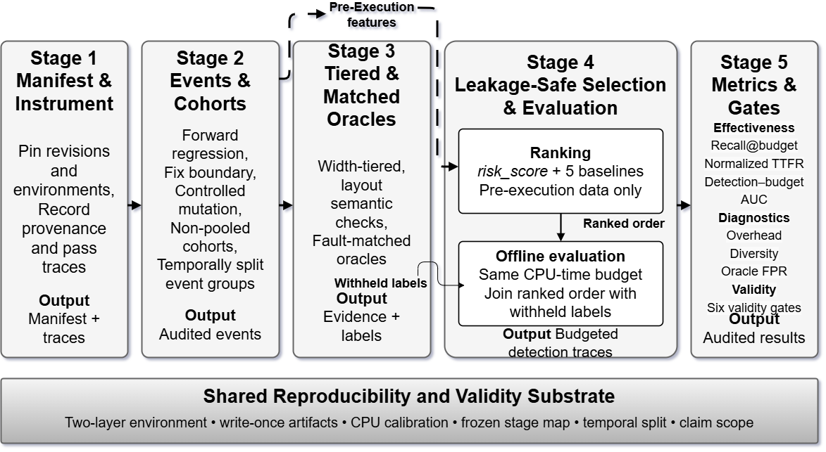
PROPOSED METHODOLOGY
The cart Pipeline
PhD Synopsis · A Leakage-Safe Framework for Observability-Aware Regression Testing of Quantum Compilers
11
Notes:
The cart methodology has five stages. Stage one pins revisions and environments and records provenance and pass traces. Stage two constructs temporally separated event cohorts, including forward regressions and fix-boundary events. Stage three applies width-tiered semantic checks and fault-matched oracles while withholding labels. Stage four is the leakage-safe selection and evaluation stage: the risk score and five baselines rank tests using pre-execution information only; the ranked order is then joined with withheld labels offline under the same CPU-time budget. Stage five computes effectiveness, diagnostic, and validity measures. Every stage rests on a shared reproducibility substrate: fixed environments, write-once artifacts, CPU calibration, frozen mappings, temporal splits, and explicit claim boundaries.

Slide 12
PROPOSED METHODOLOGY
Which Oracle Detects Which Fault?
No single oracle covers all channels — each fault channel needs its matched oracle. “Output oracle” is not one thing.
Manifestation | Unitary equiv. | Compilation | Quality | Performance | Contract | Determinism
Semantic difference | Yes | Sometimes | No | No | No | No
Compilation failure | N/A | Yes | No | No | No | No
Circuit-quality regression | No | No | Yes | No | No | No
Performance regression | No | No | No | Yes | No | No
Contract/metadata corruption | No | No | No | No | Yes | Sometimes
Non-determinism | Not in 1 run | No | Sometimes | Sometimes | Sometimes | Yes
Contract and determinism channels are not covered by the reference black-box regression screen. The framework operationalises matched checks for them — and we demonstrate that a matched contract oracle can close the gap for H1.
PhD Synopsis · A Leakage-Safe Framework for Observability-Aware Regression Testing of Quantum Compilers
12
Notes:
No single oracle covers every manifestation. A unitary-equivalence oracle is appropriate for semantic differences, while compilation validity catches failures to produce a circuit. Circuit-quality and performance regressions require dedicated thresholds or comparative measures. Contract or metadata corruption requires a contract-oriented check, and non-determinism requires repeated execution under identical conditions. The key design principle is therefore matched observability: choose the oracle according to the property that can fail. The reference black-box screen covers the first four channels, but not contract and determinism in a standard way. H1 provides the feasibility demonstration that a matched contract oracle can close one such gap.
[Sources]
- Oracle design is grounded in the equivalence and quantum-testing literature summarized on slides 9 and 21.
[/Sources]

Slide 13
PROPOSED METHODOLOGY
The Test Selector (risk_score)
Rank every candidate test by its expected value per unit cost, then run the highest-scoring first.
VALUE how much a test is worth running
chance it catches the fault × how much the fault matters × how trustworthy the check is × novelty
factors: change-stage match · circuit/backend sensitivity · criticality · historical risk · oracle confidence · novelty
COST
expected time to run
transpilation + oracle time, measured on the baseline
÷
The higher a test's value per unit cost, the earlier it runs — under a fixed test budget.
▪ Transparent: hand-set weights, no black-box AI — every choice is explainable.
▪ Leakage-safe: uses only pre-execution information, and never peeks at the outcome.
▪ Frozen & compared: weights fixed before evaluation, tested against five baselines including random, and checked by ablation.
▪ Stress-tested: conclusions hold under ±50% weight perturbation and a 10–20% reserve sweep, so no single hand-set number drives the result.
PhD Synopsis · A Leakage-Safe Framework for Observability-Aware Regression Testing of Quantum Compilers
13
Notes:
The selector ranks each candidate test by expected value per unit cost. Value combines whether the test exercises the changed stage, sensitivity of the circuit and backend, impact or criticality, historical risk, confidence in the oracle, and novelty. Cost is the measured baseline time for transpilation plus the oracle. This is an interpretable heuristic, not a learned probability and not a black-box AI model. To prevent leakage, it uses only information available before the test executes. The weights are frozen before evaluation, compared with five baselines, examined through ablation, and stress-tested with broad weight perturbations and reserve-budget sweeps. The goal is an explainable ordering that remains robust under reasonable design choices.
[Sources]
- The selection and cost-aware evaluation foundation follows the regression-testing literature summarized in [3] and [14].
[/Sources]

Slide 14
INITIAL RESULTS
What We Tested
▪ Run on a single ordinary laptop, using circuits of up to eight qubits.
▪ We ran the whole regression-testing pipeline end to end.
▪ We also reproduced real historical transpiler regressions from Qiskit’s own history.
PhD Synopsis · A Leakage-Safe Framework for Observability-Aware Regression Testing of Quantum Compilers
14
Notes:
The initial work is a feasibility study rather than a powered claim of superiority. Everything was run on one ordinary laptop, mostly with circuits of eight qubits or fewer. The purpose was to determine whether the full pipeline could execute end to end, whether its leakage and budget safeguards were implementable, and whether real historical Qiskit regressions could be reconstructed from source. This matters because the later comparison is meaningful only if the event construction, oracles, labels, ranking logic, budgets, and metrics all work together. The feasibility results show that this operational foundation exists; they do not yet replace the planned full-scale evaluation.

Slide 15
INITIAL RESULTS
Historical Transpiler Regressions Attempted
Event (PR) | Cohort | Fault type ->channel | Status
H4 (#14120) | forward_regression | Performance | verified (multi-run protocol)
H1 (#14603) | fix_boundary | semantic ->contract/metadata | demonstrated gap (output-unobservable)
H2 (#14919) | fix_boundary | semantic -> contract/metadata | not run
H3 (#14730) | fix_boundary | quality -> determinism | blocked (needs noisy target)
H5 (#16285) | fix_boundary | functional -> compilation_failure | not run (input-specific crash)
PhD Synopsis · A Leakage-Safe Framework for Observability-Aware Regression Testing of Quantum Compilers
15
Notes:
This table reports the historical events attempted and, importantly, distinguishes what has and has not been established. H4 is a verified forward performance regression under a multi-run timing protocol. H1 is a fix-boundary event that demonstrates the observability gap: semantic output equivalence passes, while a matched contract check detects the fault. H2 and H5 have not yet been run, and H3 is currently blocked because it requires a noisy target. I present these statuses explicitly to avoid treating incomplete cases as evidence. At this stage, H4 supports pipeline feasibility and H1 supports gap closability; expanding the set of forward-regression events remains part of the work plan.

Slide 16
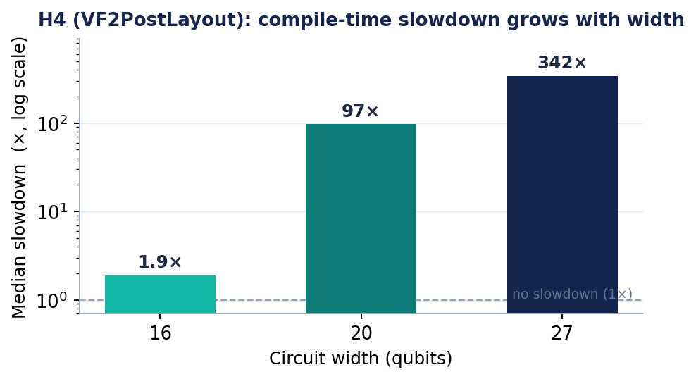
INITIAL RESULTS
H4 — A Verified Performance Regression
H4’s width-extended run (16–27 qubits) is a separate regime from the primary corpus (≤ 8 qubits).
PhD Synopsis · A Leakage-Safe Framework for Observability-Aware Regression Testing of Quantum Compilers
16
Notes:
H4 is a performance regression in VF2PostLayout. The vertical axis is logarithmic, so the growth is substantial: the median slowdown is about 1.9 times at 16 qubits, 97 times at 20 qubits, and 342 times at 27 qubits. The multi-run protocol separates a repeatable regression signal from ordinary timing noise. However, this width-extended experiment is not the same regime as the primary corpus, which is capped at eight qubits. I therefore use H4 to demonstrate that the pipeline can verify a genuine forward regression and handle performance evidence—not to generalise the plotted slowdown to the entire study population.

Slide 17
INITIAL RESULTS
H1 — The Observability Gap on a Real Regression
Oracle | Result on the buggy build
Black-box output-equivalence | EQUIVALENT (fault missed)
Property / isolated-pass (matched) | contract_metadata_fail (fault detected)
PhD Synopsis · A Leakage-Safe Framework for Observability-Aware Regression Testing of Quantum Compilers
17
Notes:
H1 is the clearest demonstration of the central thesis. On the buggy build, the black-box output-equivalence oracle reports that the compiled circuit is equivalent, so the reference screen misses the fault. A matched property or isolated-pass oracle, however, reports a contract-metadata failure and exposes the regression. Because the two checks are applied to the same real historical event, this is direct evidence that the gap is not merely theoretical. It also shows that the gap is closable: the fault becomes observable when the oracle is aligned with the failed contract. The next stage is to measure how often this pattern occurs across a larger, independently classified event set.

Slide 18
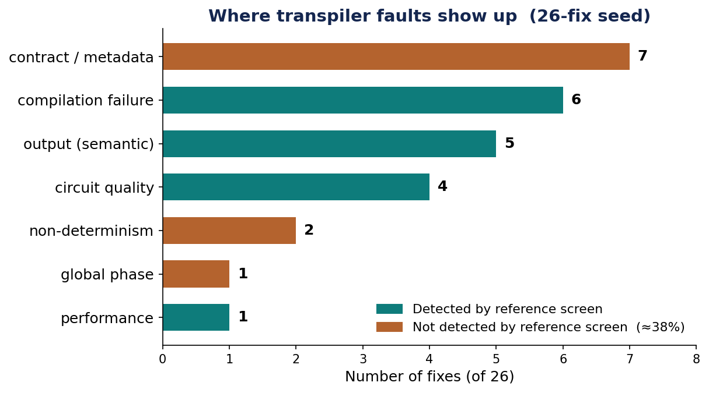
INITIAL RESULTS
Preliminary Oracle-Observability Gap in the 26-Fix Seed
PhD Synopsis · A Leakage-Safe Framework for Observability-Aware Regression Testing of Quantum Compilers
18
Notes:
The 26-fix seed gives a preliminary view of where transpiler faults manifest. Seven fixes concern contract or metadata, six compilation failure, five semantic output, four circuit quality, two non-determinism, one global phase, and one performance. The orange channels—contract or metadata, non-determinism, and global phase—sum to ten of 26, or approximately 38 percent, outside the reference screen as currently defined. This is a seed estimate, not the final prevalence claim. The full study must expand the mining, apply the classification protocol independently, report inter-rater agreement, and preserve the temporal and cohort rules before drawing a general conclusion.

Slide 19
ONE YEAR TO COMPLETION
Work Plan
Feasibility study (methodology, prototype, initial results)
Phase 1
Completed
Scale-up: verify ≥ 3 forward regressions, expand mining
Phase 2
2026 Q3
Phase 3
Comparison: selector vs baselines
2026 Q4
Phase 4
Validation and cross-SDK generalisation
2027 Q1
Phase 5
Thesis write-up and defence
2027 Q2
PhD Synopsis · A Leakage-Safe Framework for Observability-Aware Regression Testing of Quantum Compilers
19
Notes:
The remaining work is organised into five phases over one year. The feasibility study, prototype, and initial evidence constitute phase one and are complete. Phase two expands the mining and aims to verify at least three forward regressions. Phase three performs the selector-versus-baseline comparison under equal budgets. Phase four strengthens validation and examines generalisation to another software development kit, subject to the evidence and available time. Phase five completes the thesis and defence. The sequence is deliberate: I will not conduct or over-interpret the powered selector comparison before the independent forward-event target and validity conditions are satisfied.

Slide 20
SUMMARY
Where We Stand
▪ The prototype is feasible and has produced usable evidence on two real historical regression events.
▪ One real contract regression (H1) shows the reference screen can miss a fault a matched oracle detects.
▪ The 26-fix seed indicates a potentially material gap. Full mining and the comparative selector evaluation remain future work.
Thank you — Questions & discussion
20
Notes:
To conclude, the feasibility study has produced an operational prototype and usable evidence from two different historical events. H4 verifies that the pipeline can reconstruct and measure a forward performance regression. H1 demonstrates the central observability claim: a real contract fault can pass the reference output screen yet be detected by a matched oracle. The 26-fix seed suggests that the gap may be material, but that prevalence estimate and the comparative advantage of the selector remain to be established through the planned full study. The contribution is therefore a cautious, auditable path from observability diagnosis to budget-aware regression testing. Thank you. I welcome the Board’s questions and guidance.

Slide 21
REFERENCES
Selected References
[1] Paltenghi & Pradel. Bugs in quantum computing platforms: an empirical study. OOPSLA, 2022. arXiv:2110.14560
[3] Yoo & Harman. Regression testing minimization, selection and prioritisation: a survey. STVR, 2012. doi:10.1002/stvr.430
[4] Machalica et al. Predictive test selection. ICSE-SEIP, 2019. arXiv:1810.05286
[5] Paltenghi & Pradel. A survey on testing and analysis of quantum software. arXiv:2410.00650, 2024.
[6] Burgholzer & Wille. Advanced equivalence checking for quantum circuits. IEEE TCAD, 2021. doi:10.1109/TCAD.2020.3032630
[7] Paltenghi & Pradel. MorphQ: metamorphic testing of the Qiskit platform. ICSE, 2023. doi:10.1109/ICSE48619.2023.00202
[8] Javadi-Abhari et al. Quantum computing with Qiskit. arXiv:2405.08810, 2024.
[14] Elsner et al. Readily available information for regression test optimization in CI. ISSTA, 2021. doi:10.1145/3460319.3464834
[22] Pontolillo et al. QuCheck: property-based testing for Qiskit. arXiv:2503.22641, 2025.
[23] Luo et al. QEMI: testing quantum stacks via equivalence modulo inputs. FASE, 2026. arXiv:2602.09942
[24] Wang et al. QDiff: differential testing of quantum software stacks. ASE, 2021. doi:10.1109/ASE51524.2021.9678792
[25] Ye et al. QSPE: enumerating skeletal quantum programs. arXiv:2602.00024, 2026.
[26] Choudhury et al. Concolic testing for quantum compilers. IEEE ICCD, 2025.
doi:10.1109/ICCD65941.2025.00057
[27] Tao et al. Giallar: push-button verification for the Qiskit compiler. PLDI, 2022. doi:10.1145/3519939.3523431
[42] Shi et al. Contract-based verification of a realistic quantum compiler (CertiQ). arXiv:1908.08963, 2019.
[46] Oldfield et al. Faster & better quantum software testing. ACM TOSEM, 2025. doi:10.1145/3714468
[47] Kang, Lee & Oh. Statistical testing of quantum programs. OOPSLA, 2024. doi:10.1145/3689716
[48] Lee, Hong & Ryu. Exact inference for quantum circuits. ASE, 2025. doi:10.1109/ASE63991.2025.00203
[50] Burgholzer, Raymond & Wille. Verifying results of the IBM Qiskit compilation flow. QCE, 2020. doi:10.1109/QCE49297.2020.00051
[51] Ali et al. Input/output coverage criteria for testing quantum programs. ICST, 2021. doi:10.1109/ICST49551.2021.00014
[52] Wang et al. QuSBT: search-based testing of quantum programs. ICSE-C, 2022. doi:10.1145/3510454.3516839
[53] Klimis et al. Shaking up quantum simulators with fuzzing and rigour. OOPSLA, 2025. doi:10.1145/3763100
[54] Mei et al. Equivalence checking via path-sum & weighted model counting. TACAS, 2026. doi:10.1007/978-3-032-22749-2_21
[55] Ye et al. Is measurement enough? Rethinking output validation in quantum program testing. ASE (NIER), 2025. arXiv:2509.16595
Numbering follows the proposal's reference list.
21
Notes:
This slide lists the principal sources used to ground the proposal across classical regression-test prioritisation, quantum-software testing, circuit equivalence, compiler verification, and empirical bug studies. I will not read the references individually. I include them so that each major claim and methodological choice can be traced to the relevant literature. The numbering follows the full proposal reference list, which is why some numbers are not consecutive on this selected slide.
[Sources]
- The selected references are displayed on this slide; numbering follows the proposal’s full bibliography.
[/Sources]

Slide 22
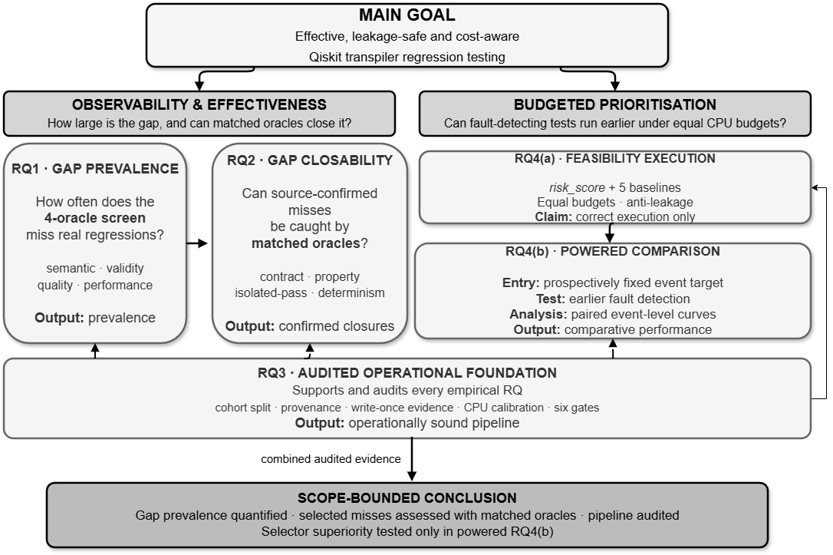
Research
Framework
22
Notes:
This framework shows how the research questions fit together. The main goal is effective, leakage-safe, cost-aware Qiskit transpiler regression testing. The left branch concerns observability: RQ1 quantifies how often the four-oracle screen misses real faults, and RQ2 tests whether matched oracles can close source-confirmed misses. The right branch concerns budgeted prioritisation: RQ4(a) establishes correct feasibility execution, while RQ4(b) performs the powered comparison only after the entry condition is met. RQ3 is the audited operational foundation supporting both branches through cohort separation, provenance, write-once evidence, calibration, and validity gates. The final conclusion remains explicitly scope-bounded to the evidence produced.

Slide 23
BACKUP — FOR QUESTIONS
Pipeline Feasibility: Validity Gates
Implementation-validity gate | Result
Budget compliance | PASS
Reproducibility (same seed ⇒ same ranking) | PASS
Leakage absence (current-event outcome cannot change ranking) | PASS
Label reproducibility from write-once artifacts | PASS
Metric correctness vs hand-computed cases | PASS
Oracle coverage | PASS
PhD Synopsis · A Leakage-Safe Framework for Observability-Aware Regression Testing of Quantum Compilers
23
Notes:
The six validity gates are executable checks on the implementation rather than informal assurances. Budget compliance verifies that every strategy respects the same resource limit. Reproducibility checks that the same seed yields the same ranking. Leakage absence confirms that changing the current event’s outcome cannot alter its pre-execution ranking. Label reproducibility traces labels back to write-once artifacts. Metric correctness is checked against hand-computed cases, and oracle coverage confirms that the required channels are represented. All six gates pass in the feasibility prototype. This supports operational soundness, but it does not by itself prove that the proposed selector is superior; that remains the purpose of the later comparison.

Slide 24
BACKUP — FOR QUESTIONS
risk_score — the Formal Definition
risk_score = ( ε + CSM ) × CBS × IP × HR × OC × NM ÷ EC
A transparent, hand-set heuristic — an interpretable score, not a calibrated probability.
ε = small additive smoothing constant
CSM = change-stage match (1 if the modified stage is exercised, else 0)
CBS = circuit-backend sensitivity
IP = impact prior (circuit criticality)
HR = historical risk (1 + prior-failure-rate)
OC = oracle confidence
NM = novelty multiplier (down-weights repeats)
EC = expected cost (transpilation + oracle time)
PhD Synopsis · A Leakage-Safe Framework for Observability-Aware Regression Testing of Quantum Compilers
24
Notes:
Formally, the risk score multiplies a smoothed change-stage match by circuit-backend sensitivity, impact prior, historical risk, oracle confidence, and a novelty multiplier, then divides by expected cost. The small epsilon prevents a zero change-stage match from automatically eliminating a potentially valuable test. Historical risk is defined as one plus the prior failure rate, while expected cost includes both transpilation and oracle time. The multiplicative form makes the reasoning transparent: a test moves earlier when it is more relevant, sensitive, consequential, historically risky, trustworthy, or novel, and later when it is expensive. The score is a hand-set ranking heuristic, not a calibrated probability of failure.

Slide 25
BACKUP — FOR QUESTIONS
Classical Foundation vs. Quantum-Specific Need
Dimension | Classical testing | Quantum transpiler
Observed result | Deterministic, directly inspectable | Probabilistic samples, internal state not directly observable
Correctness | Equality / observational equivalence | Up to global phase & qubit/layout permutation
Fault model | Crashes, wrong values, performance | + phase, entanglement, mapping/routing, backend/noise
Execution cost | Repeatable CPU time, one run | Repeated shots, simulation growth, oracle cost
Regression oracle | Expected output, assertions, logs | Output equivalence alone misses metadata/layout/quality
Foundation | Selection, prioritisation, cost, APFD/APFDc | Retained — but features, costs, oracles redefined
Classical principles are the foundation, but they do not transfer unchanged — this work is a quantum-specific adaptation and empirical validation, not the invention of regression testing.
PhD Synopsis · A Leakage-Safe Framework for Observability-Aware Regression Testing of Quantum Compilers
25
Notes:
The work builds on classical regression testing, but the concepts cannot be transferred unchanged. Classical systems usually provide deterministic and directly inspectable outcomes; a quantum transpiler must account for probabilistic observations and internal mappings. Correctness may be defined up to global phase and qubit permutation. The fault model includes routing, entanglement, phase, backend, and noise concerns, while simulation and oracle costs can grow rapidly. I retain the classical foundations—selection, prioritisation, budget accounting, APFD, and APFDc—but redefine features, costs, and oracles for quantum compilation. The novelty is this adaptation and its empirical validation, not the invention of regression testing itself.
[Sources]
- Classical prioritisation and quantum equivalence foundations are summarized in [3] and [6].
[/Sources]

Slide 26
BACKUP — FOR QUESTIONS
Evidence: Why Quantum Differs
▪ 39.9% of real quantum-platform bugs are quantum-specific — concentrated in compile/optimise components — a classical fault model is incomplete [1].
▪ Quantum outputs are exponentially large distributions — conventional distribution testing can miss phase-flip faults [46].
▪ State equivalence can’t be read from one observation — assurance needs repeated measurement, and specialised oracles expose non-crash bugs [47], [48].
▪ Equivalence checking had to be redesigned — for reversibility, superposition, entanglement — not reused from classical [6].
▪ Compiler-pass reasoning must encode quantum semantics — formal verification confirms this is necessary and feasible [27].
Central claim: classical machinery does not directly solve quantum-transpiler regression testing — its observability, oracle, equivalence and cost models do not hold unchanged.
PhD Synopsis · A Leakage-Safe Framework for Observability-Aware Regression Testing of Quantum Compilers
26
Notes:
Several findings show why a quantum-specific treatment is necessary. Empirical studies report a substantial class of quantum-platform bugs concentrated in compile and optimise components. Quantum outputs form exponentially large distributions, and conventional distribution checks can miss phase-related faults. A single observation cannot establish state equivalence, so repeated measurements and specialised oracles are needed. Equivalence algorithms themselves had to be redesigned for reversibility, superposition, and entanglement. Finally, formal work on compiler passes demonstrates that quantum semantics must be represented explicitly. Together, this evidence supports the central claim: classical testing machinery remains valuable, but its observability, oracle, equivalence, and cost assumptions do not hold unchanged.
[Sources]
- References cited on slide: [1], [46], [47], [48], [6], and [27]. See slide 21 and the proposal bibliography.
[/Sources]

Slide 27
BACKUP — FOR QUESTIONS
How Do We Evaluate Something Novel?
The method is new — the evaluation apparatus is entirely standard. We do not compare against a non-existent rival, so we do what every regression-testing study does:
▪ Established baselines: the selector is compared against random ordering plus cost-, history-, coverage/diversity- and change-based heuristics — the field-standard set [3], [10], [14].
▪ Standard metrics: APFD and cost-cognizant APFDc, recall@budget, detection-vs-budget AUC, oracle false-positive rate, inter-rater κ — all from the literature [10], [12], [40], [41].
▪ Real ground truth: evaluation on real, historical Qiskit regressions where the correct answer is known — e.g., a bug the output oracle passed but the matched oracle caught.
▪ Ablation: quantum-specific components are switched off one at a time to show which actually carry the effect — the method is compared against reduced versions of itself.
▪ Self-audit: six leakage-safe validity gates make every result reproducible and trustworthy, independent of any competitor.
▪ Unit of analysis: the regression event is the independent unit, and test–oracle pairs are nested observations, not independent replications.
PhD Synopsis · A Leakage-Safe Framework for Observability-Aware Regression Testing of Quantum Compilers
27
Notes:
A novel method can still be evaluated with standard apparatus. The selector is compared against five established baseline families: random, cost-based, history-based, coverage or diversity-based, and change-based. Outcomes use recognised measures such as APFD, APFDc, recall at budget, detection-versus-budget area under the curve, oracle false-positive rate, and inter-rater agreement. Ground truth comes from real historical regressions with known buggy and fixed revisions. Ablation removes quantum-specific components one at a time, while the six validity gates audit the implementation. Most importantly, the regression event—not each test-oracle pair—is the independent unit of analysis, preventing pseudo-replication and overstated significance.
[Sources]
- References cited on slide: [3], [10], [14], [12], [40], and [41]. See the proposal bibliography.
[/Sources]

Slide 28
BACKUP — FOR QUESTIONS
Where the Tested Regressions Come From
The events (e.g., H1 = PR #14603, H4 = PR #14120) are not “just GitHub” — for an open-source SDK the repository IS the authoritative primary record.
▪ Canonical primary source: merged pull requests, their linked issues, and release notes are the official record of what changed and why — permanent and citable.
▪ Standard methodology: mining merged bug-fix commits is established empirical-software-engineering practice [49] (the SZZ / Mining-Software-Repositories line).
▪ Same source as accepted benchmarks: Bugs4Q curates real Qiskit bugs from this history [29], and Paltenghi & Pradel mined 223 real platform bugs the same way [1].
▪ Full traceability: each event → inducing/fixing PR + issue thread + release note. All IDs, revisions and build scripts released for reproduction.
▪ Why not RFCs: Qiskit RFCs cover major design changes, not routine bug fixes — those live in the PR + release-note record, which is the correct provenance.
Every tested regression is traceable to a permanent, verifiable record — more so than most secondary sources.
PhD Synopsis · A Leakage-Safe Framework for Observability-Aware Regression Testing of Quantum Compilers
28
Notes:
The historical events are taken from the authoritative development record of the open-source software: merged pull requests, linked issues, fixing commits, and release notes. For an open-source SDK, this repository history is the primary record of what changed, why it changed, and which revisions bound the fault. Mining merged bug fixes is an established empirical-software-engineering method, and accepted quantum bug benchmarks use the same provenance. Each event in this study is traced to its inducing or fixing record, exact revisions, environment, and reproducible build scripts. RFCs are not the right source for routine defects because they document major designs; the relevant evidence for regressions resides in the pull-request and release record.
[Sources]
- References cited on slide: [49], [29], and [1]. See the proposal bibliography.
[/Sources]

Slide 29
BACKUP — FOR QUESTIONS
Do We Run Quantum Simulations? (No Hardware)
Yes — classical simulation only, on the CPU. A simulator is classical software that computes what a quantum device would do, and it never needs a quantum device.
▪ What we test is classical: the transpiler is compiler software, so checking its output is a classical computation, not a physics experiment.
▪ How the check runs: for small circuits (≤ 12 qubits) we compute the exact unitary with linear algebra (Qiskit’s classical simulator) and compare up to global phase [6].
▪ It runs on a laptop: the corpus uses up to 8 qubits, so every semantic check simulates in milliseconds on a 32 GB CPU — no device, no queue, no noise.
▪ Where simulation would blow up: above the cap we do NOT simulate — structural checks (basis + coupling-map) take over, and even the 27-qubit performance test only times the compiler, not the circuit's output.
▪ No hardware on the critical path: our research validates the compiler transformation, not physical execution — it stops one step before hardware is needed. Physical-noise fidelity is a separate, downstream question, out of scope.
Simulator ≠ hardware: it runs on an ordinary CPU. Exact simulation is exponential, so the design caps it and falls back — that is why no quantum device is needed.
PhD Synopsis · A Leakage-Safe Framework for Observability-Aware Regression Testing of Quantum Compilers
29
Notes:
No quantum processor is required for this research. The transpiler itself is classical compiler software, and the study evaluates its transformation on an ordinary CPU. For small circuits, exact unitary simulation uses classical linear algebra and compares results up to global phase. The main corpus is capped at eight qubits, so these checks remain practical. Beyond the semantic-simulation cap, the framework switches to structural checks such as basis and coupling-map validity. Even the 27-qubit H4 experiment measures compiler time rather than executing the circuit. Physical-noise fidelity is a downstream hardware question and is outside the present scope; no device, queue, or quantum-hardware access lies on the critical path.
[Sources]
- Quantum-circuit equivalence background is cited on slide as [6].
[/Sources]

Slide 30
BACKUP — FOR QUESTIONS
Precedent: Testing Quantum Compilers Without Hardware
Top-venue studies evaluate quantum compilers and quantum-software testing in classical software or simulation — none required a QPU.
Study | Venue (year) | Tier | Ran on | QPU?
Giallar [27] | PLDI 2022 | A* | symbolic pass verification (classical) | No
VOQC [44] | POPL 2021 | A* | Coq proofs over circuit semantics | No
Burgholzer et al. [50] | IEEE QCE 2020 | Nat. | equivalence checking of Qiskit compilation | No
MorphQ [7] | ICSE 2023 | A* | Qiskit simulator (8,000+ program pairs) | No
Muskit [30] | ASE 2021 | A* | Qiskit software (mutation analysis) | No
Bugs4Q [29] | ASE 2021 | A* | Qiskit buggy/fixed revisions | No
QMutPy [31] | IEEE TQE 2022 | Q1 | Qiskit software (24 programs) | No
Coverage criteria [51] | ICST 2021 | A | simulator + statistical oracles | No
QuSBT [52] | ICSE-C 2022 | A* | Qiskit as the simulation framework | No
Simulator fuzzing [53] | OOPSLA 2025 | A* | Qiskit/Cirq simulators (800,000+ circuits) | No
Exact inference [48] | ASE 2025 | A* | classical exact inference oracle | No
Tier — conferences: CORE 2023 (A* = top tier, A = strong). Journals: Scimago quartile (Q1 = top 25%). IEEE QCE is a specialised quantum venue (CORE national tier).
Our study is in exactly this established, hardware-free mode — evaluating the compiler transformation, not physical execution.
PhD Synopsis · A Leakage-Safe Framework for Observability-Aware Regression Testing of Quantum Compilers
30
Notes:
There is strong precedent for evaluating quantum compilers and testing techniques without a quantum processor. Giallar and VOQC use symbolic verification and formal proof. Other studies use equivalence checking, buggy and fixed Qiskit revisions, mutation analysis, classical simulators, statistical oracles, fuzzing, or exact inference. The table spans leading programming-languages, software-engineering, testing, and quantum-software venues, and every listed study operates in classical software or simulation rather than on a QPU. My study follows this established mode: it evaluates the compiler transformation and its regression-testing process, not physical execution on a noisy device.
[Sources]
- References cited on slide: [27], [44], [50], [7], [30], [29], [31], [51], [52], [53], and [48]. See the proposal bibliography.
[/Sources]

Slide 31
BACKUP — FOR QUESTIONS
Why Qiskit? A Fast-Moving Transpiler
Qiskit ships a new minor version about every three months — and almost every release changes the transpiler.
RELEASE VELOCITY (2.x series)
NEARLY EVERY RELEASE TOUCHES THE TRANSPILER
▪ ~3-month cadence: a new minor version on a roughly quarterly schedule (official policy).
▪ 2.0 → 2.4: five minor versions across ~2025 to mid-2026.
▪ Plus patches: 2.4.0 → 2.4.1 → 2.4.2 in quick succession.
▪ v2.2: transpilation 10–20% faster, standalone transpiler in C.
▪ v2.3: VF2Layout and VF2PostLayout reworked, custom transpiler passes in C.
▪ v2.4: faster fault-tolerant transpilation pipeline, DAG-level transpiler passes.
The passes we study are live targets: VF2PostLayout — the site of our H4 regression — was itself reworked in v2.3.
A high-churn transpiler makes every release a fresh regression opportunity, which is exactly why Qiskit — the most actively developed quantum compiler, with the richest public record of real fixes to mine — is the right subject.
PhD Synopsis · A Leakage-Safe Framework for Observability-Aware Regression Testing of Quantum Compilers
31
Notes:
Qiskit is an appropriate case because its transpiler is both influential and fast-moving. The 2.x series follows a roughly quarterly minor-release cadence, with additional patch releases, and most recent releases have changed transpilation internals or performance. Examples include the standalone C transpiler work, changes to VF2Layout and VF2PostLayout, custom passes in C, and later DAG-level and fault-tolerant pipeline improvements. This creates a rich, traceable sequence of real changes and fixes. The choice is therefore methodological, not merely convenient: high change velocity creates repeated regression opportunities, and Qiskit’s public history provides the provenance required for source-level reconstruction and temporal evaluation.
[Sources]
- Qiskit release policy and official release notes for the 2.x series, as summarized on this slide.
[/Sources]

